Slide 1


Slide 2

The New Normal
Surya Gummadi
SVP and Head of Global Markets

Slide 3
Cognizant snapshot
Our Vitals
FOUNDED
1994
(Nasdaq: CTSH)
GLOBAL
HEADQUARTERS
Teaneck, New Jersey
270+
Global
Offices
281,200
Employees
June 30, 2020
REVENUE
$4 B in Q2 2020
(down 3.4% YoY)
$16.8 B in FY 2019
(up 4.1% YoY)
REVENUE MIX
NA: 75.2%
Europe: 18.3%
RoW: 6.5%
Accolades
12
FORTUNE
Most Admired
Companies 2020
Twelve years in a row
63
FORBES
Top 100 Digital Companies 2019
194
FORTUNE 500
2020
533
FORBES
Global 2000
2020
461
FORBES
America’s Best
Employers 2019

Slide 4
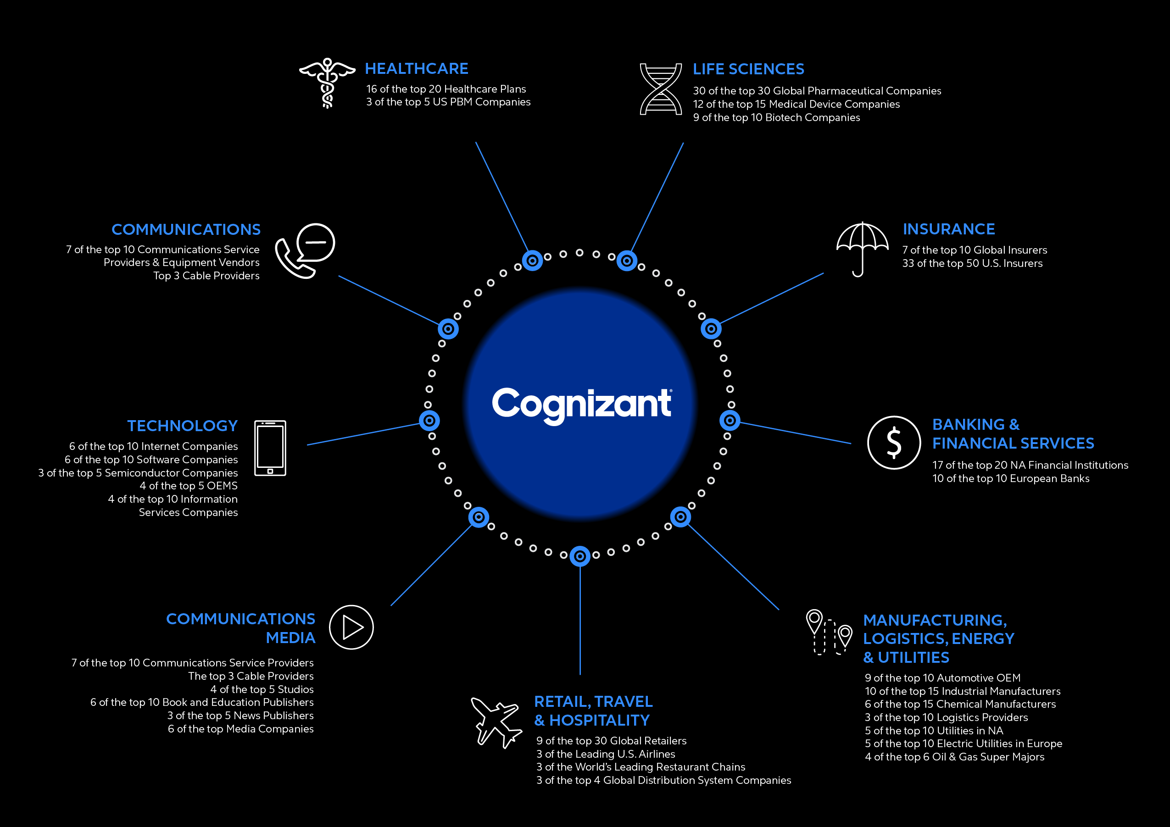


Slide 5

A global healthcare leader with an unrivaled client base across healthcare
400+ Healthcare Orgs
Over
340+ Health Systems and
347,000+ Care Providers supported through over
400 PM/EHR Partners
200 million
lives
supported
13 State Governments 30 State & Federal Exchanges
on one or more of Cognizant’s software platforms
3 of the 5 Leading US PBMs
29 of the top 30 Global Pharmaceutical companies
Digital journey
1
We optimize our leadership in the market
of digitally enabled, highly integrated and modular product solutions
2
We become the innovation leader
with the most comprehensive cloud-based SaaS and data orchestration platform
3
We continue to invest
in the TriZetto Product Suite ($100M) to support the market and client needs

Slide 6

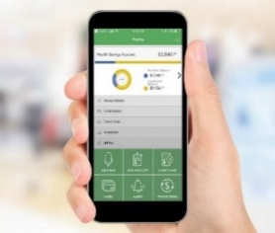





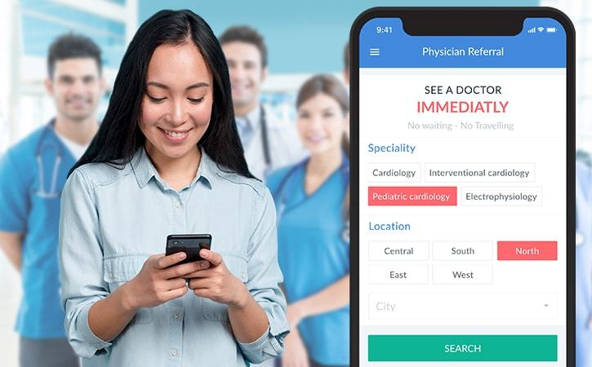
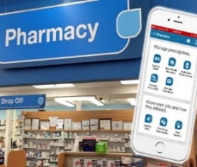

New Normal in Healthcare
Video/Virtual Visits
  2019: 36 M
  2020: 1 Billion +
Seamless Experience
Omni Channel
VIRTUALIZATION
OF CARE
Access My Care
Telehealth
Anywhere
Wearable Tracking
IOT driven diagnostics
Modular Products
Pick & Choose Benefits
Remote Diagnostic
Bundle My Benefits
Hospital @ Home
Virtual Nurse
Choose your Own PCP
MyDoctor Online
UNIFIED
PATIENT / CONSUMER
EXPERIENCE
Home Care
Pick My Doctor
E-Prescription
Digital Pharmacy
COVID-19 forced consumers and providers alike to rapidly adopt digital channels, accelerating adoption of digital channels by 30x*
Stay Informed:
Price Transparency
Any Mode of Payment: Real Time
Tele Medicine
Real time Payment

Slide 7


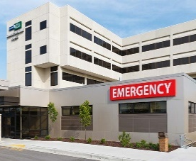

New Normal in Healthcare: Industry Alignment – Cognizant’s POV
The sudden shift to digital channels caused major disruption across Healthcare industry forcing a rapid Industrialization and Integration of virtual channels into legacy business models – A Paradigm shift
Health Insurance Company (Payer)
Hospitals (Providers)
Enable On-Demand Enrollment
Design flexible Benefit Plans – “Stack your own bundle”
Tele Health Claims Processing
Expand Provider Networks – Broader Access
Refresh Data Strategy – 360 degree Member View
Enhanced Member Experience
  Seamless virtual access
  Digital Cards
  Real-time payments
Set-up Infrastructure for Remote Patient Engagement & Management
Enable a DIGITAL Health Front Door:
  Telehealth platforms
  IOT –Remote Patient Monitoring
  Digital Interfaces for (Billing & Invoicing, Payment Processing & Prior Authorization)
Patient Engagement at Scale
  Self service options
  Nurse Help-lines
Pharmacy
Set-up Infrastructure for DIGITAL Pharmacy
  Self service platform
  E-Prescription & Re-fills
  Home delivery
Telehealth platform for remote engagement with Pharmacist and Nurses
IOT Devices for Chronic care management

Slide 8
New Normal in Healthcare

Slide 9
Summing it up
We are continuing a balanced approach of Investing in Today and Investing in Tomorrow
We are committed to Advancing the ROI of our software platforms through continued enhancement and investment
Expect us to stay ahead of the curve with respect to Emerging Technologies and new ways to Improve the Care Experience
We hope to earn the right to partner with you as we navigate the Healthcare New Normal

Slide 10

Conference Welcome
Craig Mengert
Chief Executive TriZetto

Slide 11
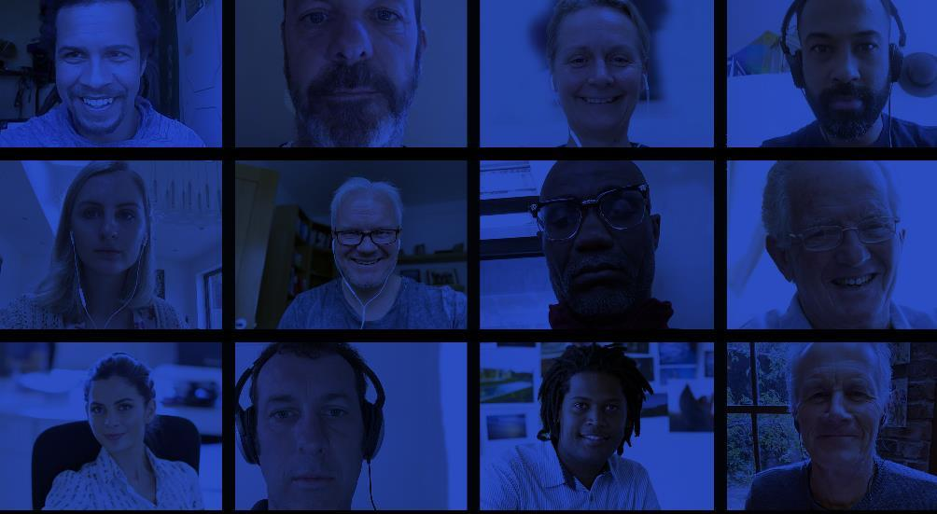
Welcome to the first
Virtual Healthcare Conference
First Virtual in xx years
Notes:
For the first time in 30 years we’re not with you live an in-person. I’m excited along with Diana we would like to welcome you to the inaugural 2020 virtual conference experience. Meeting you this way is not the next best thing it the right thing.

Slide 12

COVID-19 has changed the world
the way we work and do business
Notes:
COVID-19 has changed the world, our lives, the way we work, the way we do business. COVID-19 has changed the world, our lives, the way we work, the way we do business.

Slide 13


from
Social Distancing
to
Virtualization
Notes:
From social distancing to virtual and mobile work forces.

Slide 14

One thing that hasn’t change is our
commitment to you our client.
Notes:
The one thing is hasn't changed is our commitment to you our client.

Slide 15
We are prepared to navigate our clients through this transformation journey through our
end to end point and platform solutions
Notes:
We are prepared to navigate our clients through this transformation journey through our end to end point and platform solutions

Slide 16

110
802
Organizations
Participants
Notes:
The virtual healthcare conference will provide is and innovative and creative way to interact with you.
Brining together
770 Participants - payers, providers, health systems, Life Sciences and Strategic Partners
From 202 organizations
Representing 210M+ consumers serving OVER 70% of the US insured population

Slide 17






































































































Slide 18
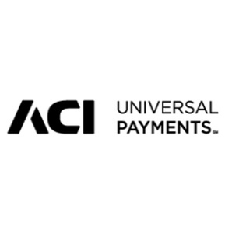

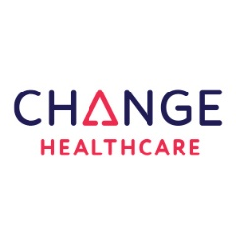






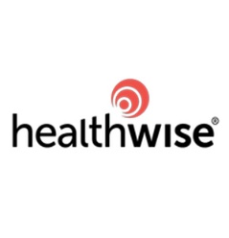









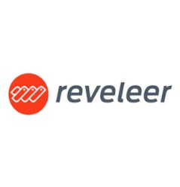



Welcome Partners
Notes:
Welcome to all of our Partners

Slide 19

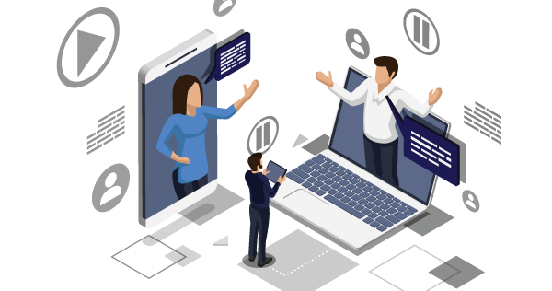
So What Has Happened Since We Last Met?
Notes:
A lot has happened since we last met in new Orleans.

Slide 20
So What Has Happened Since We Last Met?
  restructured and put a holistic TriZetto business unit together within Cognizant
  created an Interoperability solution for our clients
  implemented and/or upgraded 100+ clients virtually over the entire 2nd Quarter
Worked with Clients to help them set up Telehealth Benefits which are supported in our core admin systems
Notes:
What have we done at Cognizant/TriZetto since January

Slide 21

Restructured creating a holistic
TriZetto Business Unit

Slide 22
Craig Mengert
Chief Executive TriZetto
Mike Watkins
Chief of Staff
Jon Price
Solution Architecture
Diana Benli
Chief Product Officer (Product House)
Scott Johnson
CTO/
Architecture
John Wilson
Consulting/
Delivery Mgmt.
Chuck Sanders
Strategic Alliances
John Jastrzab
East, Government
Business Architect
Product Family Groups
(PM and Dev)
Shared Technologies
HPC- Regional Delivery, PMO, COE’s
Alliance Intake Management
Joel Olsen
PHS West
Sales Overlay
Product Portfolio Strategy and Policies
Portfolio Integration
Vendor Mgmt- Certified Partner Program
Deal Negotiation
Jose Cartagena
PHS East
MARKETS
Jim Jacobson
West
RFP
Client Experience and Product Support
R&D
Learning Services
Relationship Management
Shawn Kearl
New Logo
Product Demo
Portfolio Excellence Assurance
Third-Party Compatibility
BPS/CIS Delivery
(Dedicated HZ Leader)
Contracting
Product Regulatory and Compliance
Notes:
We restructured and put a holistic TriZetto business unit together within Cognizant
(Show Org Structure High Level) Talk about Product/Consulting/Account Management/New Sales and Strategic Solution Architecture(includes Product Demonstration, Business Architects, RFP, Contract Management and Sales Overlay
A Dedicated business team to focus on TriZetto Product solutions and Consulting Services
Re-engaging with our clients and analysts
Client Excellence

Slide 23

Solutions for our clients
Interoperability
Notes:
We created an Interoperability solution for our clients
FHIR Adapters built for Facets/QNXT (included with Open Access License(Facets) and QXI License (QNXT))
Interop Solution built on our TriZetto Healthcare Platform as a Service model

Slide 24
Cognizant Offers Solutions at
Each Point of the Journey
Connected Interop
(For all customers)
Products
API Gateway
Data Hub
Privacy & Consent Engine
Point of View
Advisory Services
For Facets & Qnxt customers
FHIR Adapters
Implementation services
Services
PMO
Business Analysis
CMS Rule
ONC Rule
Future of
Interoperability
Discovery
Product Implementation
Integration
Data
Checkpoint
Source System Uplifts
Conformance services
Staff Consulting
Testing
Monitoring
To help you understand what you must do by when
To plan, align, accelerate, and de-risk your journey
To achieve compliance and execute your unique interoperability strategy

Slide 25
What is coming?
Product Portfolio Strategy
– Diana Benli, Chief Product Officer, TriZetto
Technical Highlights
– Scott Johnson, CTO TriZetto
Partner Program and Consulting Solutions – John Wilson, Chief Services Officer, TriZetto
Notes:
What is coming?
Complete Interoperability Solution
Continue evolution on Product Portfolio Strategy (Diana and talk more coming up)
Continue to evolve and solidify our technical Strategy (Scott to talk more on this
Roll out our Cognizant Partner Program and new Consulting Solutions (John Wilson to talk more on this)

Slide 26

Product Portfolio Strategy
Diana Benli
Chief Product Officer, TriZetto

Slide 27

A foundation for growth and innovation
TriZetto Product House

Slide 28
Product and
Portfolio Strategy
One Unified Product House with deep domain solutions and expertise through product families
Client Business Solutions
Client Experience
Enterprise Architecture
Hosting and Business Processing
Product & Portfolio Families
Core Enterprise Solutions
Government Solutions
Payer Provider Solutions
Horizontal focus on improving the value and relationships with our clients
Payer Care Solutions
Systems of Engagement
Payer Platform Solutions
Product & Technology Foundations Across the Portfolio
Enabling shared technology standards and strategies across the entire portfolio
Shared Capabilities*
Cloud*
Integration*
Regulatory*
IoT
Analytics
* Current 2020 priority initiatives

Slide 29
TriZetto Product House
Solutions that enhance revenue growth, drive administration efficiency, improve cost and quality of care, and enrich the member and patient experience
Product Lines - Key Capabilities
Core Administration Platform of choice for
150+ Payers
Core Administration Solutions
Engagement Solutions
QNXT | Facets | QicLink
  TriZetto Systems of Engagement
360+
Payer Clients
Care Management Solutions
Connected Solutions
  CareAdvance | Value Based Benefits |
  Touchless Authorization Processing
  Interoperability
200 M+
Total lives managed
Payer Provider Solutions
Optimization Solutions
NetworX | TruProvider | Payment Bundle Administrator
  AI | Machine Learning | RPA
20
Serving of the top
Health Plans
Government Solutions
Quality Management Solutions
25
TriZetto Elements, including Encounter Data Manager (EDM)
ClaimSphere | StarSERV | Clinical +

Slide 30
Our Portfolio – Available and in Planning
TriZetto Healthcare Products Group
Core Payer and TPA Admin Solutions
Payer-Provider Solutions
Government and Quality Solutions
Care Solutions
Data Orchestration SoE Solutions
Facets – Payer Core Administration
QNXT – Payer Core Administration
QicLink - TPA Core Administration
  NetworX Pricer and Modeler
  Provider contract pricing and modeling
  NetworX PBA & Analytics - Bundled payment administration
  TriZetto Elements for Government Programs CMS enrollment and recon gateway, full encounter data management, Risk Adjustment analytics, forecasting, reporting
  ClaimSphere QaaS Quality improvement as a Service
  StarSERV Medicare STARS quality measures and reporting
  CareAdvance Enterprise
  Care, Disease and Utilization management
  Value-Based Benefits for Member incentive management automation
  TriZetto Healthcare Platform Integrated data aggregation
  and orchestration
  Systems of Engagement connected constituent engagement enablement solutions (including Engage and CWS portals, Treatment Cost Navigator (TCN) and Provider POS Direct
EXISTING PRODUCTS
(Commercially available)
  Platform Analytics – integrated cost and utilization analytics
  Connected Interoperability
  TruProvider Provider onboarding and credentialing
  Clinical+ - P-P convergence for care gap closure
  TTAP automated real-time authorization/referral processing
assessment to begin in Q3-2020
PLANNING
(Commercialization underway)
pre-commercialization
final commercialization in Q3-2020
early adopter through Q3-2020
phased commercialization beg. in Q1-Q4 2020

Slide 31

Interoperability Solutions for our clients
  TriZetto® Interoperability Adapter
  TriZetto® Interoperability Data Hub
  TriZetto® Interoperability Privacy & Consent Engine
  TriZetto® Interoperability API Gateway
    The adapter integrates data from TriZetto® Core Administrative Systems and converts to the HL7® FHIR® standard for ingestion into data lakes and adherence to your requirements.
    Makes data from administrative and clinical systems securely available at scale, by ingesting, de-duplicating, cleansing and moving into a data lake where it stays at rest or is orchestrated in real-time.
    A configurable data processing tool that delivers functionality to support requirements and manage consent, audit, privacy and security records.
    Enables authenticated access to data from diverse sources (core systems, clinical systems and administrative systems) on-demand.
Notes:
Our SaaS products enable on-demand data access is securely delivered by building privacy, consent, security and authentication into the foundation of the solution.
TriZetto® Interoperability Adapter
The adapter integrates data from TriZetto® Core Administrative Systems and converts to the HL7® FHIR® standard for ingestion into data lakes and adherence to your requirements.
TriZetto® Interoperability Data Hub
Makes data from administrative and clinical systems securely available at scale, by ingesting, de-duplicating, cleansing and moving into a data lake where it stays at rest or is orchestrated in real-time.
TriZetto® Interoperability Privacy & Consent Engine
A configurable data processing tool that delivers functionality to support requirements and manage consent, audit, privacy and security records.
TriZetto® Interoperability API Gateway
Enables authenticated access to data from diverse sources (core systems, clinical systems and administrative systems) on-demand.

Slide 32
TriZetto Portfolio Strategy
Continuous value - now and into the future
1
We optimize our leadership in the market
of digitally enabled, highly integrated and modular product solutions
2
We become the innovation leader
with the most comprehensive cloud-based SaaS and data orchestration platform
3
We disrupt the industry
by opening and connecting our products and platforms to new communities and marketplaces
  Continue to focus on enhancing our existing key products within our product house to deliver market-leading, digitally enabled, end-to-end solutions—inclusive of partnerships—for our clients and our BPaaS offerings. Focus on strengthening integration and introducing more modularity and reusability across the portfolio.
  Expand through the TriZetto Healthcare platform to become the most comprehensive integration, data orchestration, and data interoperability solution in the healthcare market. This expansion shall enable key solution offerings ‘over’ the platform, aligned with our strategic campaigns, such as interoperability, systems of engagement, transparency and analytics insights.
  Open our products and platform to create development exchanges that support multiple communities:
  Client marketplace
  Enveloped partner marketplace
  Development/partner community
  Analytics and insights community
2019-2021
2020-2022
2022-2025

Slide 33
Portfolio Roadmap Themes
  Enabling Technologies
  Leveraging technology to support digital capabilities, improved deployments, and open, flexible, cloud-enabled solutions
  Optimized Experience
  Enabling a tailored experience that enables user efficiency and satisfaction
  Market Vision
  Leading the industry by enhancing the solution capabilities that transform it
  Intelligent Operations
  Embedding agility through process automation and integration
  Portfolio wide User Centered Experience Design standards
  Self-service and workflow within
  Business Intelligence and data visualization (360 views)
  Modularity
  Cost and Transparency
  Interoperability
  Delivery System Transformation - inclusive of Value-based care, reimbursement, benefit design
  Member experience – access, holistic individual health, engagement and retention
  Regulations and Government programs
  Portfolio Integration strategy
  Native RPA
  AI/ML – insights inside, outside and round-trip
  Enterprise workflow
  Infrastructure / Cloud - Containers, DevOps, CI/CD, SaaS
  AI/ML – insights inside, outside and round-trip
  Open Access – APIs, Streaming, Event-driven architecture and data aggregation

Slide 34

Portfolio Foundational
Initiatives
Next
  Componentization/ Modularity
  XD – Experience Design
  SaaS
  Data Visualization
  IOT
  Analytics/AI/Insights
Now
  Modernization
  Engagement
  Cloud
  Integration
  Interoperability
  API Management
  Automation/RPA
Later
  Marketplaces/Communities
  Platforms that Scale
Here
  Correspondence
  Workflow
  Security

Slide 35
True partnerships = success: messages from our clients
“I think the partnership Cognizant is establishing through this with us is AMAZING!”
-QNXT Client
“Billing 360 is Awesome! It brings all the information together in a single place and it has made us more efficient.”
-Facets Client
“…thank you for your partnership…you were there alongside with us through thick and thin. Your dedication during these last few months as we ramped toward Go-Live, and over this last weekend when we pushed to production is greatly appreciated.”
-Care Advance Client
“…great work performed by the Cognizant team who helped us implement both the EAM and FRM Elements systems. Due to their diligent work ethic, knowledge, and skilled expertise, our implementation was a success. We implemented on time and under budget, which is always something that a small local non-profit organization like ours, appreciates.”
-Elements Client
“The HEDIS retrospective engine was delivered six weeks ahead of time. This has been by far the best software implementation of my career to date and I’ve done everything from EMR to EDI software implementations over the year.”
-ClaimSphere Client
“With NetworX Pricer, we have significantly reduced configuration time and manual pricing. Our auto-adjudication has also increased resulting in reduced labor costs and increased turn-around time for claims payment. NetworX Modeler is done in a few hours instead of weeks…”
-NetworX Client
“TCN tool successfully made it to PROD last night at 11:45pm… I sincerely thank each one of you on your hard work in getting this project successful.”
-TCN Client
“I have undergone many implementations in my career but the systems and service at Cognizant are something very unique. The level of expertise and support from the ClaimsExchange, QicLink and NetworX delivery teams exceeded our expectations. …the team at Cognizant can help you design a solution, that meets your needs for success. They will serve you as if this was for their own use. That is the foundation of integrity and success.”
–QicLink and ClaimsExchange Client
“Wonderful tool! Very quick to upload. User friendly, we had little training but it was intuitive and I could pick up a lot from just using it more. Great job!!!!!”
-Clinical+ Client
“We are consistently receiving greater than 98% acceptance on submitted claims, this is more than 2% higher than the National Small Plan Average as reported on the CMS Encounter Data Report Cards. The improvements in our EDPS submissions has also had a positive impact on our revenue.”
-EDM Client
“We have had great success with the VBB product and plan to expand its rollout to other states.”
-VBB Client

Slide 36

Technical Strategy
Scott Johnson
Chief Technology Officer, TriZetto

Slide 37

COVID-19 has forced businesses to adapt. Emphasis on
Mobile workforce
Cloud
Privacy and Security
Automation & AI
Notes:
COVID, Business Continuity putting an emphasis on virtualization, cloud, mobile workforce, AI

Slide 38

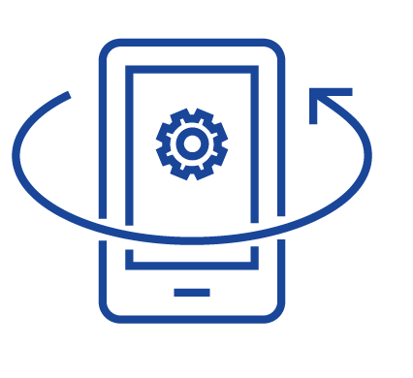



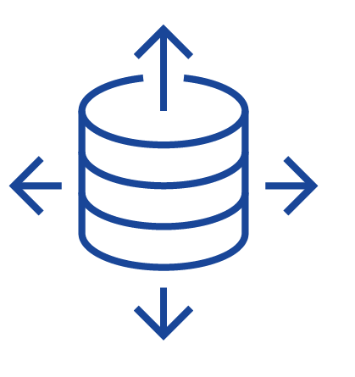
Highlights across the portfolio
Cloud-first development model
Continuous Integration & Deployment / Container-based Solutions
Robotic Process Automation to improving efficiency
{ REST }
Interoperability, and open Access
Single-page-application interfaces supported by REST service libraries.
Seamless integration of AI and ML algorithms
Notes:
The optimizations we are making across the portfolio will improve the overall cost of ownership, reduce deployment complexity, and ultimately provide significant flexibility in how you achieve your overarching cloud adoption goals
quick update on our development progress migrating to cloud-first model
update on continuous integration, continues deployment, and the role of container-based solutions going forward
Deep, meaningful automation through Cognizant RPA and introduction of service-based automation improving efficiency and stability of bots
Seamless integration of AI and ML investments through platforms such as Facets Insights
Interoperability, and open Access
our approach open Access continues to evolve. Influenced by IOT patterns, streaming and data pub/sub patterns are the next iteration of integration capabilities within the portfolio. Early adopters having success
Migration of our products to single-page-application style interfaces underpinned by REST service libraries.
Comments regarding customer feedback and user-centered design methodologies embraced by community
Closing comments on our commitment to technology currency and supporting innovation within and around our portfolio

Slide 39

We have become the market leader by continually, thoughtfully and strategically evolving our technology to take full advantage of the latest innovations in software design, architecture and deployment.
Notes:
Closing comments on our commitment to technology currency and supporting innovation within and around our portfolio

Slide 40

TriZetto consulting Services
and Partner Program
John M. Wilson
Chief Services Officer, TriZetto

Slide 41
TriZetto Services; Adjusting to the New Normal
  restructured and now part of the TriZetto business unit while also part of our Healthcare global delivery team
  implemented and/or upgraded 100+ clients projects virtually since the lockdowns – thanks for the partnership!
  developing services to help effectively deploy the modernized and new TZ products such as the solutions for the Cloud and Interoperability
Focused on driving more value for our clients as they deploy new solutions and Optimize existing software and solutions
Notes:
What have we done at Cognizant/TriZetto since January

Slide 42
TriZetto Healthcare Product Consulting (HPC) Focus Areas for 2020
Improve ability to deliver virtually from any global location for the ‘new normal’
Improve collaboration
with Client Account teams to better serve clients
Focus on TCO
and Value via updated SDLC, Optimization Practice
Continue Globalization Program and E2E solutions such as our Configuration Factories
Align with TZ Product House to combine services with software for digital solutions
Enhance tools and automation to streamline projects and optimize for the Cloud

Slide 43
CoE Functions – delivering better outcomes
Process optimization
Benefit Factory
Automation Driven
Upgrade Factory
Simplification & Standardization
CENTER OF
EXCELLENCE
Best Practices & Guidelines
Hybrid SDLC with Outcomes Focus
Repeatability & Reusability
Expanded Globalization
Data Driven
Optimization Assessments
Platform Stability & Scalability

Slide 44
Digital COE incubated in HPC to help drive transformation
Cloud workload Migrations
Upgrade Factory
Application Management
Data Analytics / Dashboards/ AI/ML
Interoperability Factory
Data Streaming/Pub
API/Micro services/RTCA
Containerization Factory
Devops
1000+ certified product resources 100+ certified digital resources

Slide 45
TriZetto Optimization Tools
Core-Specific Solutions
Core-Agnostic Solutions
Configuration Migration Utility (CMU)
Surgically promote configuration changes (Facets)
Security Management Tool (SMT)
Manage security provisioning (Facets)
Facets Enrollment Toolkit (FET)
Automate electronic enrollment record processing (Facets)
Supplementary Mapping Management (SMM)
Modify and analyze supplementary qualifier, procedure, revenue rules (Facets)
Keyword Loader (KWL)
Load diverse data types directly to Facets (Facets)
QNXT Configuration Solution (QCS)
Automate configuration data change management (QNXT)
Third-party Interfaces
CHC interfaces for Claims Integrity solution (QNXT)
Claim Test Pro (CTP)
Execute thousands of claims processing use cases
(Any Core Solution)
Test Data Generator (TDG)
Clone randomized non-production data sets (Facets/QNXT)
Synthetic Executable Enterprise Data (SEED)
Create PHI-free member and claim data (Any Core Solution)
Configuration Data Analyzer (CDA)
Analyze claim data for test use case fulfillment
(Any Core Solution)
EDI Transaction Generator (EDITran)
Create compliant 834s, 837s, and other EDI formats from generic input files (Any Core Solution)
Third-party Interfaces
Zelis Payments and Payments Integrity Solutions (Facets/QNXT)

Slide 46
We understand that some clients prefer to work with additional services vendors so we are launching our
TriZetto Consulting Partner Network
To help you deliver more value to your business
Notes:
COVID, Business Continuity putting an emphasis on virtualization, cloud, mobile workforce, AI

Slide 47
TriZetto Services Sessions and Demonstrations at the VHCC 2020
Learning Services: TriZetto University Update/
Demonstrations; Learning
@ Scale
Tools: Creating Test Data w/o PHI: Masked & Synthetic Data Creation Options
Learning Services: Adapting your Learning Culture to a #SuddenlyRemote World
Update on new service offerings such as for Cloud, Interoperability and ASO Management
Achieve more value from your software investments; Optimization and HealthCheck
Driving down TCO with Globalization and Factory approaches, such as for Benefits and Upgrades

Slide 48
Thank you for participating in our first
Virtual Healthcare Conference
Surya Gummadi
SVP and Head of Markets
#CognizantHCC

